Slide 1


Debjani Chatterjee
-Developer Advocate(Communities)

Slide 2
Agenda
Session 3 - Karan
Code Patterns
Starter kits for the hackathon
Session 1 - Debjani
What is Call for Code?
What is Call for Code India Challenge Hackathon?
Resources for the hackathon
Session 3 - Debjani
Submission guidelines
Timeline and winner announcement info
3. QnA
Session 2 - Yuktesh
IBM Cloud overview
Services and Catalog
DevRel / CFC-India / April 10, 2020 / © 2020 IBM Corporation

Slide 3
Are you on Slack Yet? bit.ly/ibm-dev #prayudh-cfc-india #ibm-account-issues-only

Slide 4
The reality

Slide 5

“We are at a critical point in the global response to COVID-19 – we need everyone to get involved in this massive effort to keep the world safe.”
Dr. Tedros Adhanom Ghebreyesus
WHO Director-General
“…the disease that is ravaging our world.”
-UN News
“…now threatening all of humankind.”
-UN News
“…the true fight of our lives.”
-UN News

Slide 6

“The climate crisis is caused by us - and the solutions must come from us. We have the tools: technology is on our side.”
António Guterres Secretary-General of the United Nations
*Background image: 2019 Call for Code Winner Prometeo’s field test, Barcelona, Spain, February 2020
75%
of earth’s carbon emissions are caused by our cities .
1/4
of people are likely to live in chronic water shortage areas by 2050.
37m people are severely effected by natural disasters every year.

Slide 7
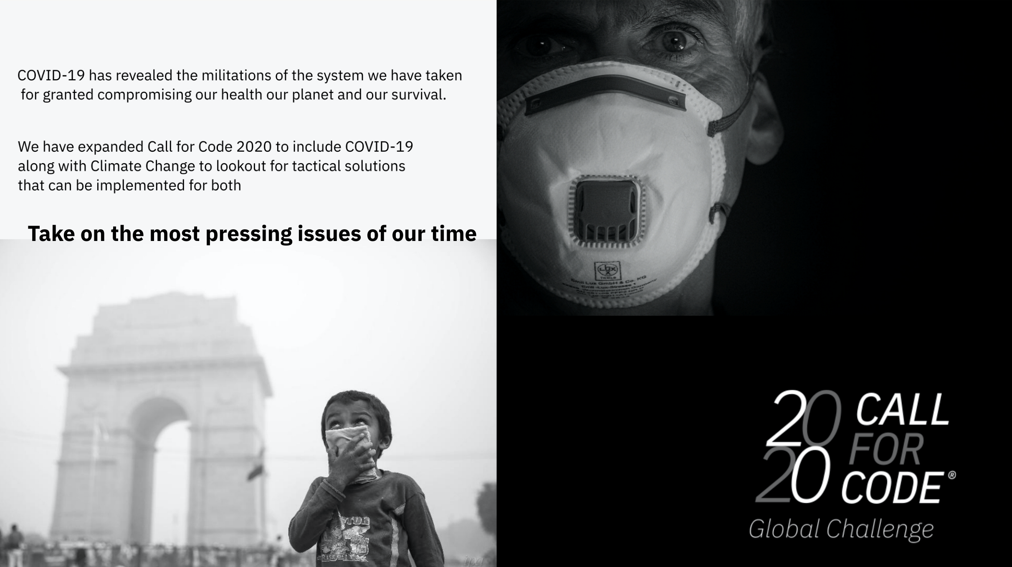

Slide 8
What the world needs to fight Climate Change

Slide 9

Water sustainability
Energy sustainability
Disaster resiliency
2B+
People are living with risk of
reduced access to freshwater resources
60%
Total greenhouse gas emissions are due to current energy methodologies
1M
People have died because of natural disasters since the turn of the century

Slide 10
What the world needs to fight COVID-19

Slide 11

Crisis Communication
Remote Education
Community Cooperation
When a new disease emerges, communications systems are one of the first systems to be overwhelmed
School closures & social distancing is leaving students at home for an indeterminate amount of time
Understanding what is happening in your neighborhood & how you can give & get help is vital in uncertain times

Slide 12
What action can you take now?

Slide 13
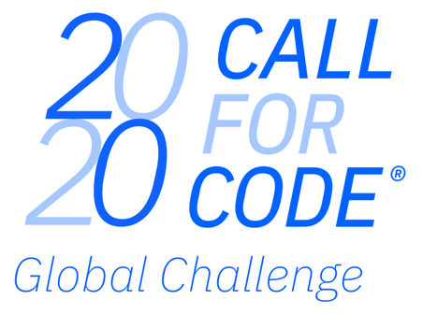



Build solutions that fight back.
Build & deploy solutions to help seize & reduce the impact of COVID-19
Build & deploy solutions to help halt & reverse the impact of Climate Change
In 2020, Call for Code is aligned to the UN 75th anniversary global conversation theme of climate change, with a focus on:
water sustainability
energy sustainability
disaster resiliency
The 2020 Call for Code Global Challenge is being expanded to address the COVID-19 pandemic, with a focus on:
crisis communication
remote education
community cooperation
Join a movement of:
210,000+ problem solvers
165+ nations
8,000+ applications built
Have the chance to win:
$200,000 USD
Open Source support from The Linux Foundation
Meetings with mentors & potential investors
Implementation support through Code and Response™
Call for Code Founding Partner
Call for Code Creator
Call for Code Charitable Partner
Call for Code Affiliate

Slide 14
Previous Call for Code winners
Call for Code 2019 Winner, Prometeo
A first of its kind, hardware-software solution equipped with sensors that detect toxicity levels for firefighters battling wildfires in real time, offering a transformative solution to first-responders globally
Technology: IBM Cloud IoT Platform, IBM Cloud services, Cloudant database
https://www.youtube.com/watch?v=iPI9NJkXLuA

Slide 15
Previous Call for Code winners
Call for Code 2018 Winner, Project Owl
A groundbreaking hardware-software solution that automatically constructs a mesh network via small Wi-Fi units allowing for sustained communications in peak times of need
Technology: IBM Watson Studio, IBM Cloud IoT Platform
https://www.youtube.com/watch?v=lc4amiOIy9A

Slide 16

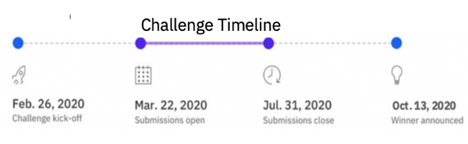

Build solutions that fight back.
Join a movement of:
210,000 developers, data scientists & problem solvers
165+ nations
8,000+ applications built in the prior 2 years
Help seize & reduce the impacts of the COVID-19 pandemic by addressing:
Crisis Communication
Remote Education
Community Cooperation
Help halt & reverse climate change by addressing:
Water sustainability
Energy sustainability
Disaster resiliency
Have the chance to be awarded:
$200,000 USD
Open Source support from The Linux Foundation
Meetings with mentors & potential investors
Solution implementation support through Code and Response™
Register for the challenge and start building
Important links :
Accept the challenge: https://developer.ibm.com/callforcode/
Covid-19 Starter Kits/timelines :
https://developer.ibm.com/callforcode/getstarted/covid-19/
Climate Change Starter Kits/timelines :
https://developer.ibm.com/callforcode/getstarted/climate-change/
↓

Slide 17
Common Guidelines(both tracks), Next Steps and our resources ..
We should leverage the available resources well to create our build & deployable solutions to help seize & reduce the impact of COVID-19 and Climate Change.
Mentoring
Learn. Create. Share
IBM Developer consists of code patterns, open source code, tutorials, tech talks, resources, learning series to accelerate. Climate Change, with a focus on:
water sustainability
energy sustainability
disaster resiliency
IBM Cloud Platform
Availability of 190+ unique services to help quickly start building your deployable solution. Register Here(Accept the Challenge) or if you already have one then Login here
Watson AI services
Weather Data
Analytics engine
Container platform
Mobile platform
Dedicated slack workspace to communicate with one another & collaborate with IBM Mentors. https://callforcode.org/slack
Mentoring & guidance throughout from IBMers from across technology domains.
COVID-19 pandemic, with a focus on:
crisis communication
remote education
community cooperation

Slide 19

Prayudh
bit.ly/cfc-india

Slide 20

Timeline & Guidance
April 2, 2020
April 10, 2020
April 15, 2020
April 22, 2020
April 27, 2020
Join the Call Accept the challenge & Register
Network & Form teams (~4 to 5 members) & join dedicated Slack workspace
Webcast and enablement
Go through Starter Kits & Technical Library
Ideate on a Call for Code – Tracks & use cases
Zero in on a problem statement.
Identify IBM Cloud services
Draw up the solution architecture diagram.
Start Building your solution with your teams and leverage IBM Cloud services
Short Video – summing up your solution Submit – India challenge submission deadline.
GitHub code repository, video, slides etc.
Results announced on webcast at 2PM
Global Challenge -Initial submissions deadline
Constant IBM Mentoring

Slide 21

NOTICE TO
EMPLOYEES AND REPRESENTATIVES OF
GOVERNMENT OWNED ENTITIES
At this IBM function, IBM is providing refreshments and/or promotional items and considers this a normal business courtesy. Some organizations or local government agencies do not permit their employees to accept food or refreshments from contractors doing business with them.
IBM provides this notice to assist you in ensuring that your acceptance of the amenities is in compliance with your employer’s internal policies. If your receipt of the amenities during your attendance and participation in the event presents an issue, please advise IBM.
Notes:
On that note this is an IBM advisory manadated for any event, since we have goodies and prizes for you folks, okay, moving on..

Slide 22
Submissions
Mail your link for the submission
- publicly accessible GitHub repository- (or other location such as GitLab or Box)
Mail id
ibmcode@in.ibm.com
Portal
bit.ly/cfc-india

Slide 23
QnA

Slide 24


Join our Meetup groups
Bangalore: https://bit.ly/ibm-blr
Delhi and NCR: https://bit.ly/ibm-delhi
Mumbai: https://bit.ly/ibm-mumbai
Pune: https://bit.ly/ibm-pune
Hyderabad: https://bit.ly/ibm-hyd
Chennai: https://bit.ly/ibm-chennai
Courses and tutorials (earn badges)
https://cognitiveclass.ai
Check out the IBM Developer website
https://developer.ibm.com/
Code Patterns
Join the community on Slack
bit.ly/ibm-dev
Notes:
Let us quickly move on to taking a quick feedback from you guys and we will continue QnA future topics and more.
Cognitiveclass.ai is a free platform for learning
- where you can Earn badges and showcase on LinkedIn for your portfolio
- Expand your knowledge with courses for all skill levels
Developer.ibm.com
Is a repository of learning paths, tutorials, and open source projects. You have access to Code patterns which offer up complete solutions to problems that developers face every day. Code patterns leverage multiple technologies, products, or services to solve issues that our developer advocates have recognized as common use cases across multiple industries.

